Slide 1

MINOR PROJECT
BUDGET TRACKER
Presented by:-
Yashans Joshi, R2142220299, CSE
Priyanshi Bhatt, R2142220277, CSE
Ria Singhal, R2142220618, CSE
Ayush Dwivedi, R2142220780, CSE
Guided by:
Dr. Mohammad Ahsan
School of Computer Science

Slide 2
CONTENT
Introduction
Literature Review
Objectives
Methodology
Working Model
Results
Conclusion
References

Slide 3
INTRODUCTION
Budget tracker is a software or application that helps you keep track of your expenses. It can be used to track your spending daily, weekly, monthly, or yearly. Expense trackers typically allow you to categorize your costs, so you can see where your money is going. They can also help you set budgets and track your progress toward your financial goals. When choosing an expense tracker, it is important to consider your needs and budget.
The Budget Tracker project focuses on simplifying the process of income and expense tracking, providing users with an efficient way to manage their finances. With an intuitive interface, this solution bridges the gap between income and expenses, offering users a faster, smoother experience. The system is designed to cater to users of all financial literacy levels, making it easy to monitor daily spending, categorize expenses, and set budgets.

Slide 4
LITERATURE REVIEW
The research by Hezretov (2021) presents a mobile application, "Budget Tracker," developed using React Native for both Android and iOS platforms. This app aims to simplify budgeting by offering an interactive, user-friendly interface for tracking expenses, managing monthly incomes, and recurring payments. The application uses the Agile Scrum methodology to deliver user-centered features and iterative improvements. The study highlights the app's focus on performance and reliability, employing AsyncStorage for local data persistence. However, challenges like simplifying the UI without compromising usability and the absence of a PDF export feature for report viewing were noted. Future enhancements are planned to include PDF export and more reporting options, such as bar graphs and pie charts, targeting students and working individuals initially, with expansion for a broader audience in the future.
In the study by Bhujang et al., the "Expense Tracker and Budget Planner" is presented as a dynamic solution for personal and business financial management. The app provides an online platform for users to log, categorize, and analyze their expenditures, with features aimed at better money management and financial planning. By setting budgets and monitoring spending habits, users can avoid overspending and optimize their finances. The project emphasizes financial awareness, helping users save for future goals. The application’s potential to predict future expenses and offer financial advice is also noted, positioning it as a valuable tool for empowering users to make smarter financial decisions.

Slide 5
OBJECTIVE
The project aims to have the following features:-
Empowering Financial Control: Emphasize how the app empowers users to take control of their finances, enabling them to make informed decisions about their money.
Time and Efficiency Savings: Highlight how the app saves users valuable time by automating expense tracking, compared to traditional manual methods like spreadsheets.
Real-time Insights: Showcase the benefit of real-time insights into spending habits, allowing users to adjust their budgets and financial plans on the fly.
Long-term Financial Goals: Encourage users to think beyond just expense tracking and consider the app as a tool for achieving long-term financial goals.
User-friendly Experience: Demonstrate the user-friendly JavaSwing interface, making it easy for both tech-savvy and non-tech-savvy individuals to manage their expenses.

Slide 6
METHODOLOGY
STEPS
Conceptual Design & Requirement Gathering:
Define the core features (tracking expenses, categorization, reporting).
Identify user interface requirements using JavaSwing.
Research libraries for file handling, data storage, and UI components.
UI Development with JavaSwing:
Build the UI structure using JavaSwing components.
Apply CSS for styling to ensure a user-friendly, consistent interface.
Integrate animations and layouts to improve user interaction.
Core Functional Development:
Develop backend logic for expense data storage and retrieval.
Implement data manipulation features (add, edit, delete expenses).
Integrate features for report generation and visualization.

Slide 7
METHODOLOGY
Testing & Quality Assurance:
Conduct unit testing for each feature.
Perform integration testing for UI and backend.
Conduct cross-platform testing (Windows, macOS, Linux).
Deployment & Documentation:
Prepare user guide and setup documentation
Package the application for different OS platforms
Finalize delivery with technical documentation and maintenance plan

Slide 8
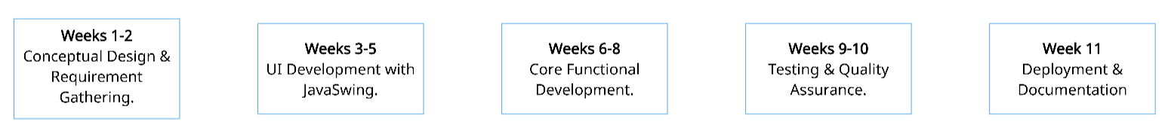
TIMELINE

Slide 9
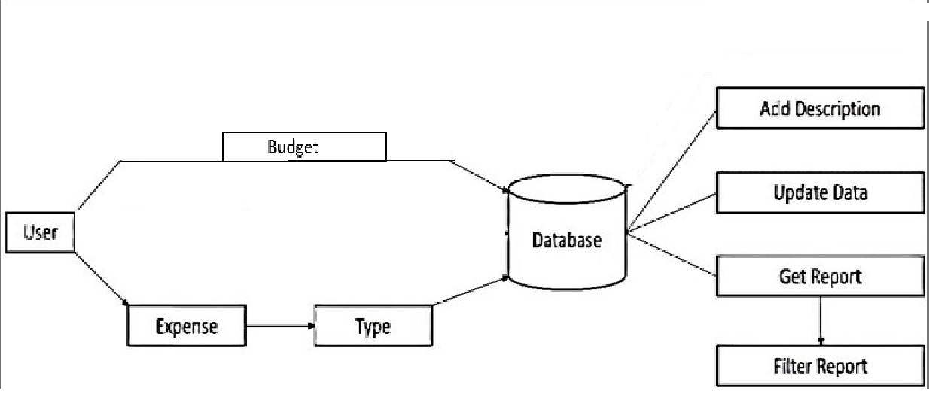
WORKING MODEL
Fig.1 Methodology Chart

Slide 10
WORKING MODEL
SRS: https://1drv.ms/w/c/d47c90232b0df75b/EYYtIgqDZnZNrBYvKIIwqB8BJdfTUcH3TeM6d7mWGZVuVg?e=l0fANK
Requirements Analysis & Planning:
Defined feature list and UI components.
Documented requirements and created user flow diagrams.
UI Implementation with JavaSwing:
Built a functional UI prototype with CSS styling.
Conducted UI testing and collected user feedback.
Backend Development:
Developed backend functionality for expense data processing.
Integrated report generation features and performed initial testing.

Slide 11
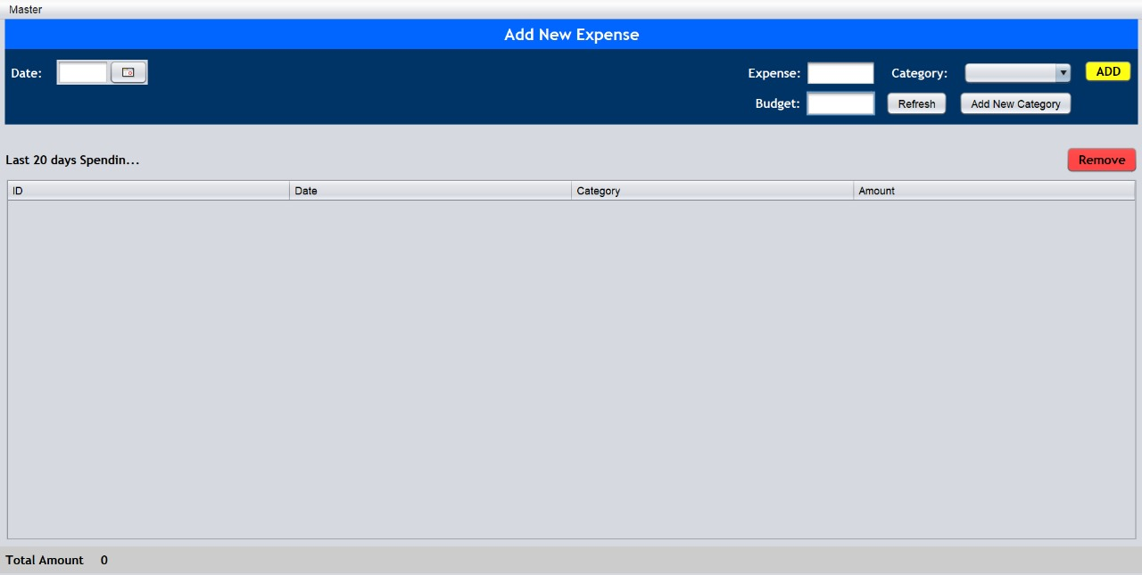
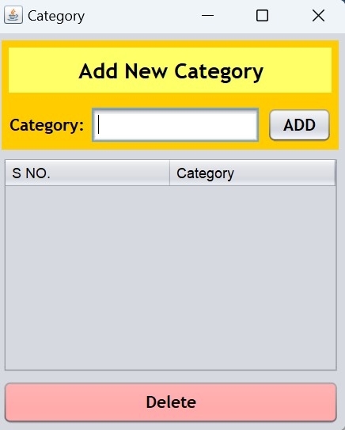
RESULT
Main Window
Category Window

Slide 12
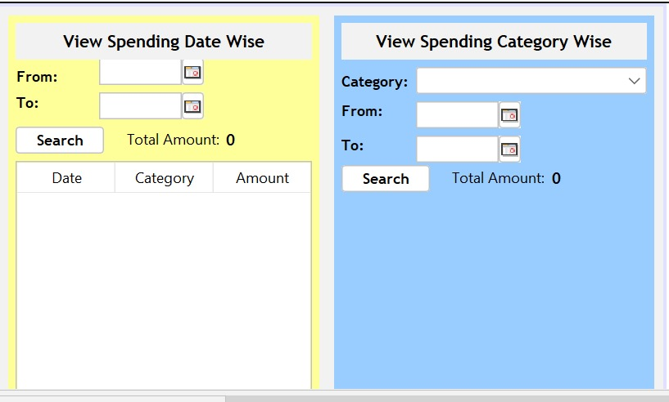
RESULT
View Spending Date Wise Window

Slide 13
CONCLUSION
JUSTIFICATION OF OBJECTIVES:
Enhanced Financial Tracking for Users:
The primary objective of this project is to create a user-friendly expense tracker that empowers users to manage their finances more effectively. By organizing expenses into categories and providing insights through reports, the application enables users to better understand and control their spending habits.
Cross-Platform Accessibility:
Java’s cross-platform capability ensures that this expense tracker can be used on Windows, macOS, and Linux, allowing it to reach a diverse user base. This objective ensures flexibility and accessibility for users who operate across different systems, meeting the demand for seamless financial tracking without compatibility concerns.
Intuitive and Engaging User Interface:
Using JavaSwing, the objective is to create a visually appealing, responsive UI that makes tracking expenses straightforward and enjoyable. With CSS customization, the tracker can maintain a professional and clean interface, helping users quickly engage with the tool without a steep learning curve.

Slide 14
CONCLUSION
Efficient Data Storage and Retrieval:
Efficiently storing and retrieving data is essential for this project’s objective of providing timely and accurate financial insights. The backend is structured to handle data storage, retrieval, and manipulation quickly, so users can access and interact with their financial information instantly.
Scalability for Additional Features:
The modular design objective supports future scalability, enabling additional features to be incorporated with ease. By building a foundation that can be expanded in the future, the project aims to provide lasting value to users.

Slide 15
CONCLUSION
FUTURE SCOPE:
Multi-user Support for Family or Group Expense Tracking:
Enabling multi-user support could allow families or groups to collectively track and manage shared expenses. This feature would provide group summaries and allow the tracker to be a collaborative tool for household budgeting.
Advanced Reporting and Visualization Options:
Expanding the reporting features with customizable, advanced visualizations (such as monthly, yearly, and custom date range analyses) would provide users with deeper insights into their spending trends. This could also include export options to Excel, PDF, or CSV for detailed financial analysis.
Mobile Application Version:
Developing a mobile version of the application would increase its accessibility and convenience. With the growing demand for mobile finance management apps, this scope would cater to users who prefer managing finances on the go.

Slide 16
REFERENCES
Hezretov, M. (2021). Budget Tracker Highly Customizable Budgeting Mobile Application (Doctoral dissertation).
Bhujang, B. D., Wendole, P. V., Thakare, A. P., Ghodele, P. C., & Khan, S. W. (2024). “Expense Tracker and Budget Planner”, International Journal of Progressive Research in Engineering Management and Research (IJPREMS), vol. 4, issue 1, pp. 615-616.
Michael J. Hernandez, “Database Design for Mere Mortals” Published by Addison-Wesley, 2013.
"Java Documentation" - Oracle: The official Java documentation is a valuable resource for Java development and best practices.
"JavaSwing Documentation" - Oracle: we can refer to the official JavaSwing documentation for insights into JavaSwing development and user interface design

Slide 17

THANK YOU

